Slide 1
Many to Many Relationships and SQL
Ling Xue

Slide 2
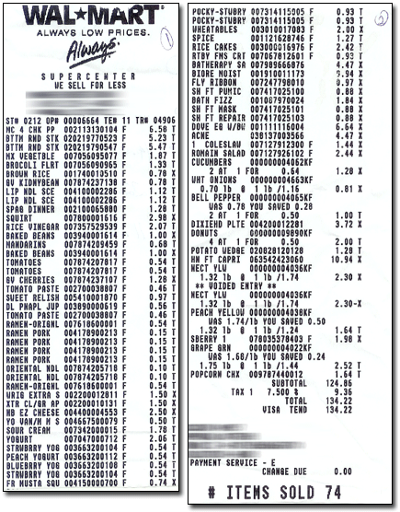
Notes:
http://www.mdmproofing.com/iym/products/receipt-splitter/

Slide 3
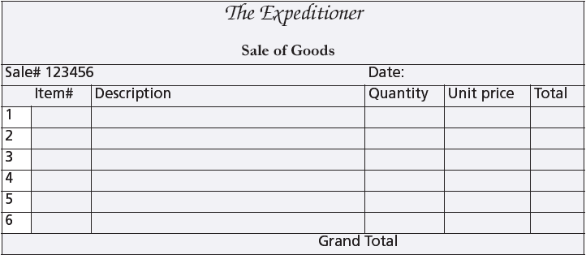
A sales form

Slide 4
Many-to-many relationship
SALE
*saleno
Saledate
saletext
ITEM
*itemno
itemname
Itemtype
itemcolor

Slide 5
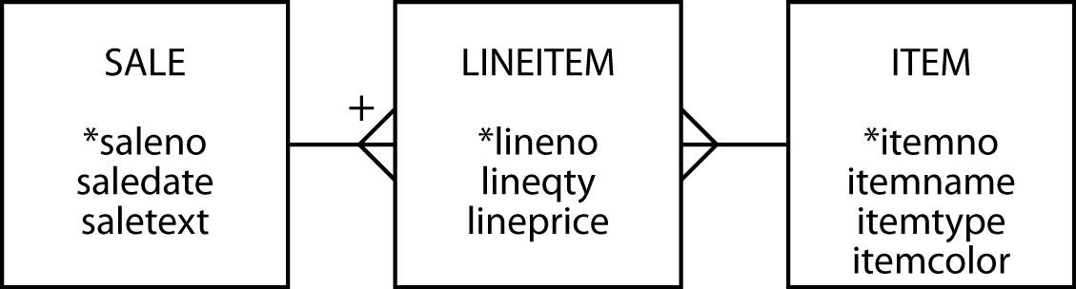
The many-to-many relationship
Create a third entity to map an m:m relationship
An associative entity
The + on the crow's foot indicates that LINEITEM is identified by concatenating saleno and lineno
LINEITEM is known as a weak entity, and it has an identifying relationship with SALE

Slide 6
Preference settings
Foreign key same name as primary key
Associative table name of form tableA_tableB

Slide 7
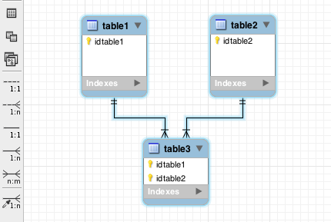
Many-to-many relationship
MySQL Workbench
m:m symbol

Slide 8
Many-to-many relationship
MySQL Workbench
Identifying
relationship
Non-identifying
relationship

Slide 9
Associative Entity: Weak Entity
Weak Entity: an entity set
depend on other entities; cannot exist by itself
does not have sufficient attributes for Unique Identification of its records
Example:
A loan entity can not be created for a customer if the customer doesn’t exist;
A dependents list entity can not be created if the employee doesn’t exist
An associative entity is a weak entity
Strong Entity: an entity set
independent of any other entity
has its own primary key attribute
Example: An employee entity can exist without needing any other entity

Slide 10
Creating a relational database
Same rules apply
The associative table has two foreign keys
One for each of the entities in the m:m relationship
A foreign key can also be part of the primary key of an associative entity
lineitem
lineno | lineqty | lineprice | saleno | itemno
1 | 1 | 4.50 | 1 | 2
1 | 1 | 25.00 | 2 | 6
2 | 1 | 20.00 | 2 | 16
3 | 1 | 25.00 | 2 | 19

Slide 11
Why a third entity?
Store data about the relationship
Convert an m:m as two 1:m relationships

Slide 12
Creating a relational database
CREATE TABLE sale (
saleno INTEGER,
saledate DATE NOT NULL,
saletext VARCHAR(50),
PRIMARY KEY(saleno));
CREATE TABLE item (
itemno INTEGER,
itemname VARCHAR(30) NOT NULL,
itemtype CHAR(1) NOT NULL,
itemcolor VARCHAR(10),
PRIMARY KEY(itemno));
CREATE TABLE lineitem (
lineno INTEGER,
lineqty INTEGER NOT NULL,
lineprice DECIMAL(7,2) NOT NULL,
saleno INTEGER,
itemno INTEGER,
PRIMARY KEY(lineno,saleno),
CONSTRAINT fk_has_sale FOREIGN KEY(saleno) REFERENCES sale(saleno),
CONSTRAINT fk_has_item FOREIGN KEY(itemno) REFERENCES item(itemno));

Slide 13
A three table join
Specify two matching conditions with the associative table in both join conditions
SELECT * FROM sale JOIN lineitem
ON sale.saleno = lineitem.saleno
JOIN item ON item.itemno = lineitem.itemno;

Slide 14
A three table join
List the names of items, quantity, and value of items sold on January 16, 2011
SELECT itemname, lineqty, lineprice, lineqty*lineprice
AS total FROM sale JOIN lineitem
ON lineitem.saleno = sale.saleno
JOIN item ON item.itemno = lineitem.itemno
WHERE saledate = '2011-01-16';
itemname | lineqty | lineprice | total
Pocket knife—Avon | 1 | 0.00 | 0.00
Safari chair | 50 | 36.00 | 1800.00
Hammock | 50 | 40.50 | 2025.00
Tent—8 person | 8 | 153.00 | 1224.00
Tent—2 person | 1 | 60.00 | 60.00

Slide 15
In-class Practice
Use ClassicModels database.
Write a query to list out the names of products, their product line and the number of customers that have purchased them.
Write a query to list out the product vendor and the number of different customers they have shipped orders to.
Write a query to list the names of customers that have ordered products from only a single productline.

Slide 16
EXISTS
Existential qualifier.
Returns true or false.
Returns true if the table contains at least one row satisfying the specified condition.
Report all clothing items (type “C”) for which a sale is recorded
SELECT itemname, itemcolor FROM item
WHERE itemtype = 'C'
AND EXISTS (SELECT * FROM lineitem WHERE lineitem.itemno = item.itemno);
itemname | itemcolor
Hat—Polar Explorer | Red
Boots—snake proof | Black
Pith helmet | White
Stetson | Black

Slide 17
SELECT Distinct itemname, itemcolor FROM item, lineitem
WHERE itemtype = ‘C’ AND lineitem.itemno = item.itemno;

Slide 18
itemno | itemname | itemtype | itemcolor
1 | Pocket knife—Nile | E | Brown
2 | Pocket knife—Avon | E | Brown
3 | Compass | N | —
4 | Geopositioning system | N | —
5 | Map measure | N | —
6 | Hat—Polar Explorer | C | Red
7 | Hat—Polar Explorer | C | White
8 | Boots—snake proof | C | Green
9 | Boots—snake proof | C | Black
10 | Safari chair | F | Khaki
11 | Hammock | F | Khaki
12 | Tent—8 person | F | Khaki
13 | Tent—2 person | F | Khaki
14 | Safari cooking kit | E | —
15 | Pith helmet | C | Khaki
16 | Pith helmet | C | White
17 | Map case | N | Brown
18 | Sextant | N | —
19 | Stetson | C | Black
20 | Stetson | C | Brown
SELECT itemname, itemcolor FROM item
WHERE itemtype = 'C’
AND EXISTS (SELECT * FROM lineitem WHERE lineitem.itemno = item.itemno);
lineno | lineqty | lineprice | saleno | itemno
1 | 1 | 4.5 | 1 | 2
1 | 1 | 25 | 2 | 6
2 | 1 | 20 | 2 | 16
3 | 1 | 25 | 2 | 19
4 | 1 | 2.25 | 2 | 2
1 | 1 | 500 | 3 | 4
2 | 1 | 2.25 | 3 | 2
1 | 1 | 500 | 4 | 4
2 | 1 | 65 | 4 | 9
3 | 1 | 60 | 4 | 13
4 | 1 | 75 | 4 | 14
5 | 1 | 10 | 4 | 3
6 | 1 | 2.25 | 4 | 2
1 | 50 | 36 | 5 | 10
2 | 50 | 40.5 | 5 | 11
3 | 8 | 153 | 5 | 12
4 | 1 | 60 | 5 | 13
5 | 1 | 0 | 5 | 2
itemname | itemcolor
Hat—Polar Explorer | Red
Boots—snake proof | Black
Pith helmet | White
Stetson | Black

Slide 19
NOT EXISTS
Returns true if the table contains no rows satisfying the specified condition.
Report all clothing items (type “C”) that have not been sold.
SELECT itemname, itemcolor FROM item
WHERE itemtype = 'C'
AND NOT EXISTS
(SELECT * FROM lineitem
WHERE item.itemno = lineitem.itemno);
itemname | itemcolor
Hat—Polar Explorer | White
Boots—snake proof | Green
Pith helmet | Khaki
Stetson | Brown

Slide 20
itemno | itemname | itemtype | itemcolor
1 | Pocket knife—Nile | E | Brown
2 | Pocket knife—Avon | E | Brown
3 | Compass | N | —
4 | Geopositioning system | N | —
5 | Map measure | N | —
6 | Hat—Polar Explorer | C | Red
7 | Hat—Polar Explorer | C | White
8 | Boots—snake proof | C | Green
9 | Boots—snake proof | C | Black
10 | Safari chair | F | Khaki
11 | Hammock | F | Khaki
12 | Tent—8 person | F | Khaki
13 | Tent—2 person | F | Khaki
14 | Safari cooking kit | E | —
15 | Pith helmet | C | Khaki
16 | Pith helmet | C | White
17 | Map case | N | Brown
18 | Sextant | N | —
19 | Stetson | C | Black
20 | Stetson | C | Brown
SELECT itemname, itemcolor FROM item
WHERE itemtype = 'C'
AND NOT EXISTS
(SELECT * FROM lineitem
WHERE item.itemno = lineitem.itemno);
lineno | lineqty | lineprice | saleno | itemno
1 | 1 | 4.5 | 1 | 2
1 | 1 | 25 | 2 | 6
2 | 1 | 20 | 2 | 16
3 | 1 | 25 | 2 | 19
4 | 1 | 2.25 | 2 | 2
1 | 1 | 500 | 3 | 4
2 | 1 | 2.25 | 3 | 2
1 | 1 | 500 | 4 | 4
2 | 1 | 65 | 4 | 9
3 | 1 | 60 | 4 | 13
4 | 1 | 75 | 4 | 14
5 | 1 | 10 | 4 | 3
6 | 1 | 2.25 | 4 | 2
1 | 50 | 36 | 5 | 10
2 | 50 | 40.5 | 5 | 11
3 | 8 | 153 | 5 | 12
4 | 1 | 60 | 5 | 13
5 | 1 | 0 | 5 | 2
itemname | itemcolor
Hat—Polar Explorer | White
Boots—snake proof | Green
Pith helmet | Khaki
Stetson | Brown

Slide 21
Exercise
Report all brown items that have been sold
Report all brown items that have not been sold
Using ClassicModels
List the first and last name of employee’s with the title ‘Sales Rep’ that do not service any Customers.
List the names of products that have not been ordered.

Slide 22
Set operations
UNION
Equivalent to OR
INTERSECT
Equivalent to AND

Slide 23
Union
Combine the output (of multiple queries) together into a single result table.
Each query must output the same number of columns.
UNION compatible
Output from each query should have compatible data types for each column.

Slide 24
UNION
List all items that were sold on January 16, 2011, or are brown.
SELECT itemname FROM item JOIN lineitem
ON item.itemno = lineitem.itemno
JOIN sale ON lineitem.saleno = sale.saleno
WHERE saledate = '2011-01-16'
UNION
SELECT itemname FROM item WHERE itemcolor = 'Brown';
itemname
Hammock
Map case
Pocket knife—Avon
Pocket knife—Nile
Safari chair
Stetson
Tent—2 person
Tent—8 person

Slide 25
INTERSECT
List all items that were sold on January 16, 2011, and are brown.
SELECT itemname FROM item JOIN lineitem
ON item.itemno = lineitem.itemno
JOIN sale ON lineitem.saleno = sale.saleno
WHERE saledate = '2011-01-16'
INTERSECT
SELECT itemname FROM item WHERE itemcolor = 'Brown';
itemname
Pocket knife—Avon
INTERSECT not supported by MySQL

Slide 26
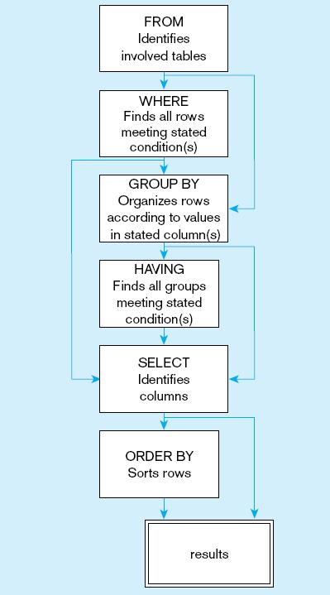
General Syntax of the SELECT statement
SQL statement processing order
Notes:
The SELECT clause specifies which columns to return. The FROM clause specifies from which tables these columns come. The WHERE clause specifies conditions that determine whether a row is returned in the results. GROUP BY and HAVING are used for aggregate queries and ORDER BY determines sorting. Note that queries can also include subqueries, so you may see a SELECT inside another SELECT.

Slide 27
Tips for Developing Queries
Be familiar with the tables and primary key and foreign key pairs.
Know the attributes desired in result.
Identify the tables that contain desired columns.
Construct a ON to join tables.
Fine tune with GROUP BY and HAVING clauses if needed.
Sort the result using ORDER BY.
Notes:
It is important to test your query against a set of test data that includes unusual data, missing data, impossible values, etc.

Slide 28
Query Efficiency Considerations
Instead of SELECT *, identify the specific columns in the SELECT clause; this helps reduce network traffic of result set.
Limit the number of subqueries; try to make everything done in a single query if possible.
Subqueries can be very useful, but can also cause computational overload. This is especially true for correlated subqueries.
If data is to be used many times, make a separate query and store it as a view.
Notes:
Suppose for example, you have a correlated subquery where the outer query is processing through 10,000 rows. This means the subquery would execute 10,000 times!
This is another reason it is important to test your queries. Not only must they be able to execute, but they should produce valid results and also do it in a reasonable amount of time.

Slide 29
Conclusion
Introduced
m:m relationship
Associative entity
Weak entity
EXISTS
Set operations

